Slide 1
Transportation in Medellin
A Story about Accessibility, Inclusion, and Innovation
OSSEN Group Project #7

Slide 2
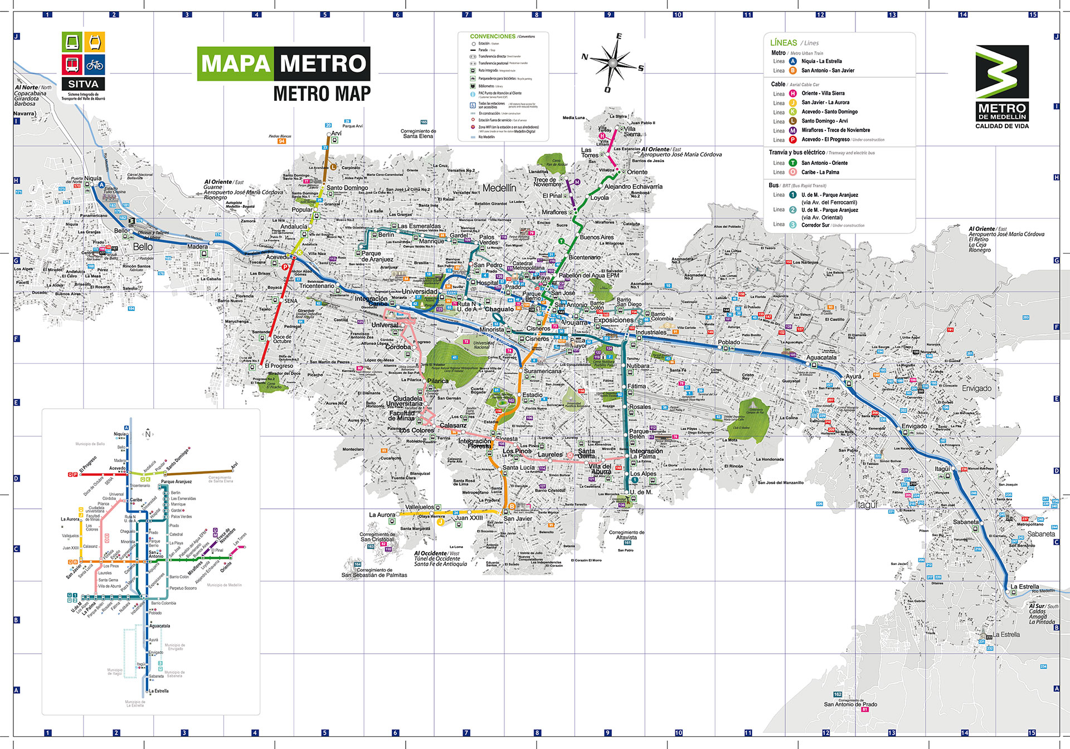
Transportation in Medellin

Slide 3
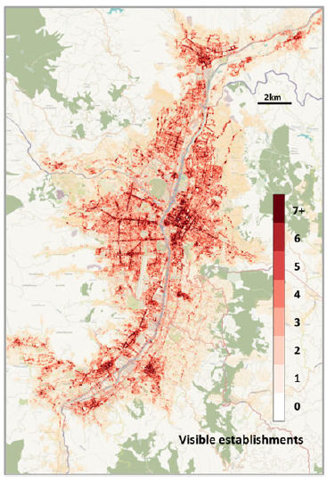
Activity in Medellin
Straulino D, Saldarriaga JC, Gómez JA, Duque JC, O’Clery N. 2022 Uncovering commercial activity in informal cities. R. Soc. Open Sci. 9: 211841.

Slide 4
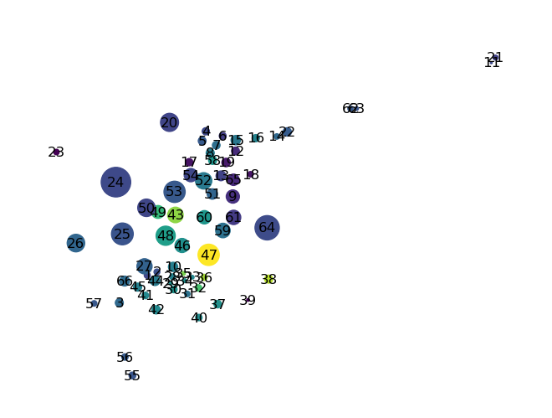
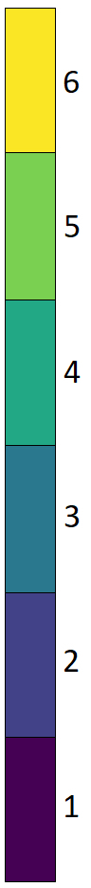
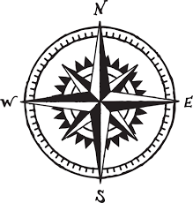
A Different Perspective

Slide 5
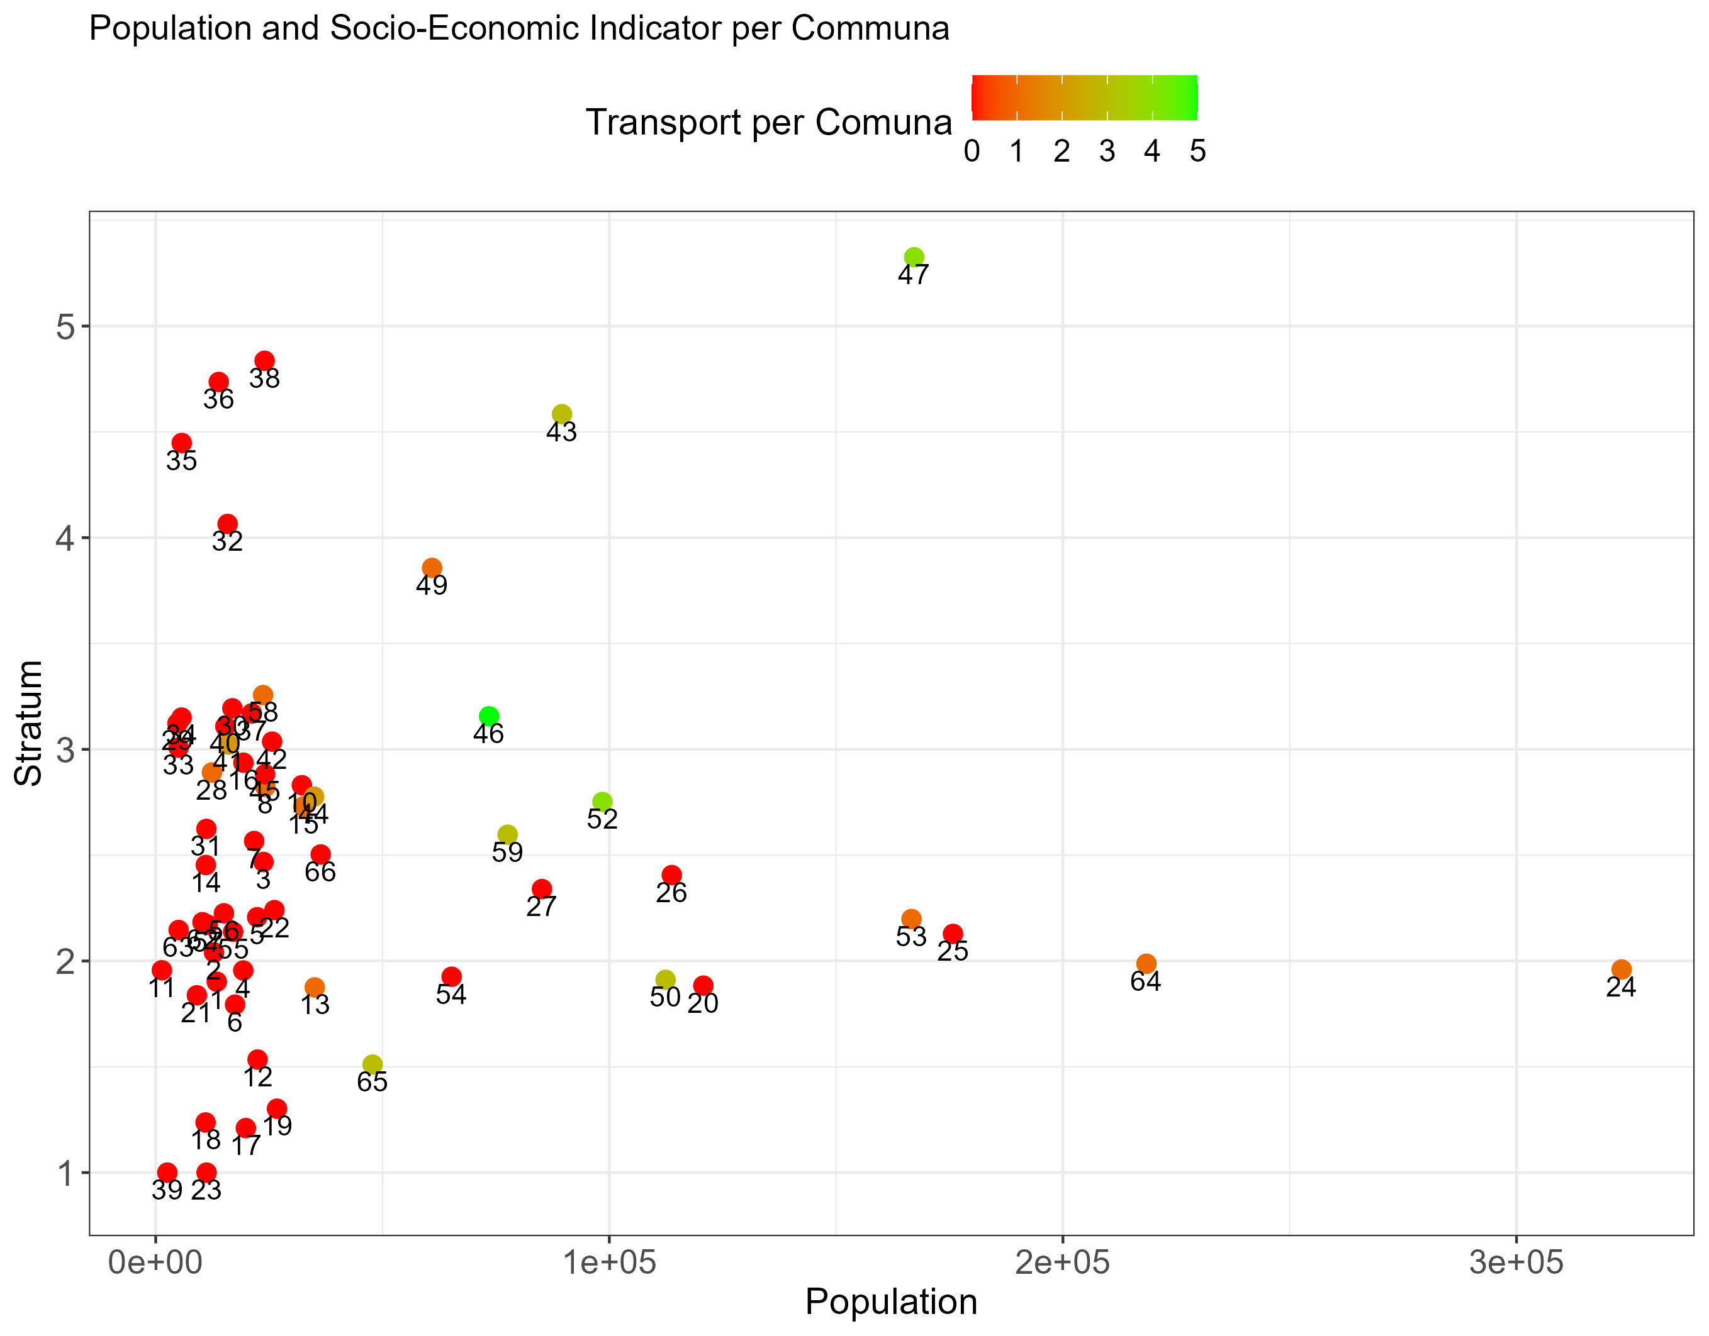
The Exclusion

Slide 6
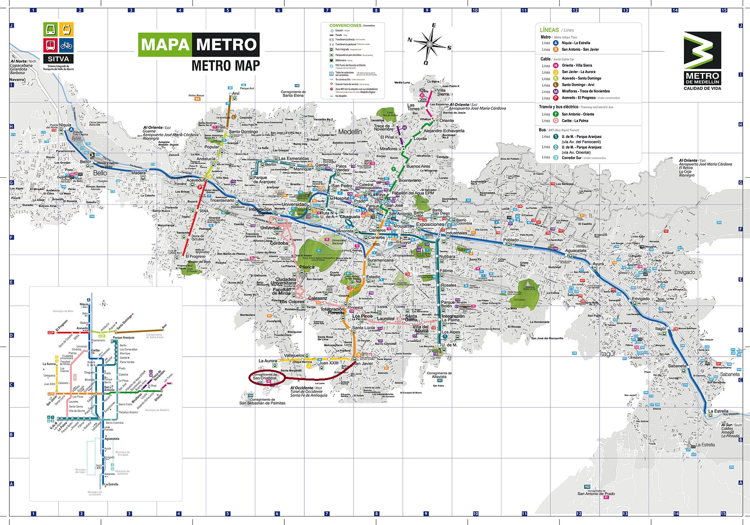
The Inclusion
We propose an extension of Line B from San Javier to San Cristobal (24).

Slide 7
The Opportunity
Spatial Unconstrained Gravity Model
Currently, people in San Cristobal are held back due to the lack of accessibility
We predict a medium size inflow of economic activity into the community
In general, we were able to showcase the unused potential in Medellin of public transport
We further propose additional investment into the expansion of the current system

Slide 9

The Model
$$T_{ij}=KO_{i}D_{j}\exp\left(−β_{ij}\right)$$
Subject to
$$∑_{i=1}^{n}∑_{j=1}^{m} T_{i,j}=T$$

Slide 10
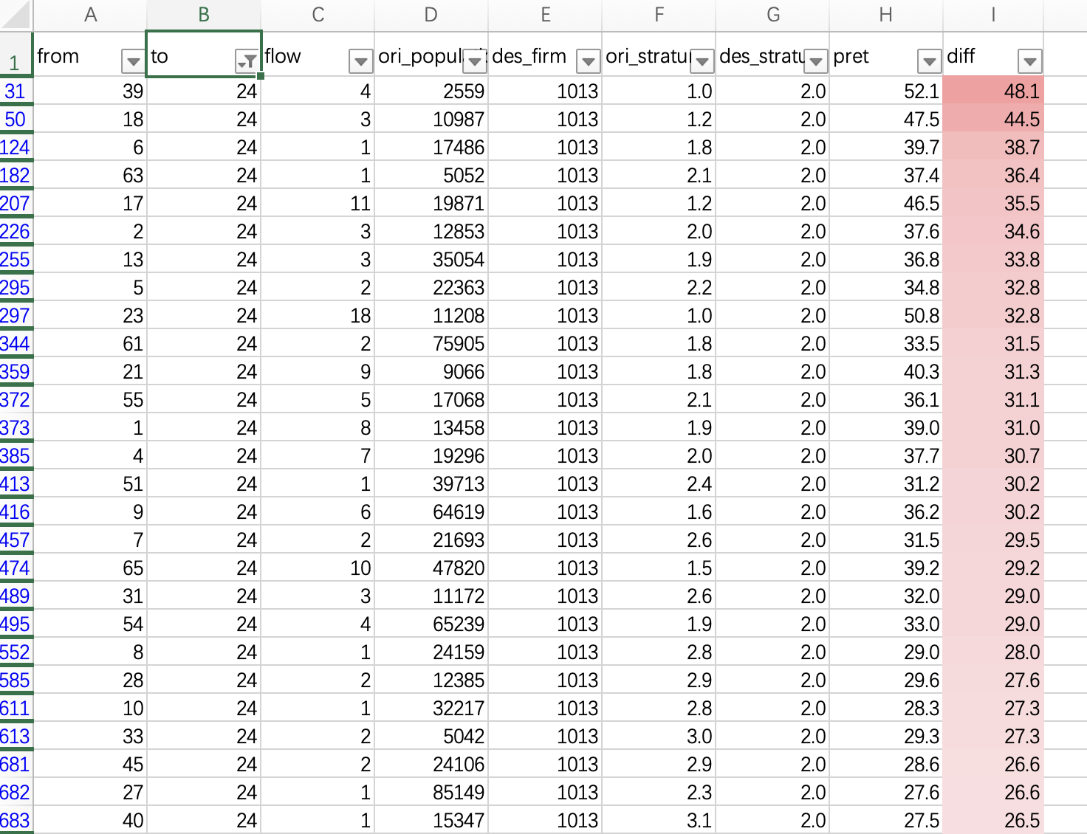
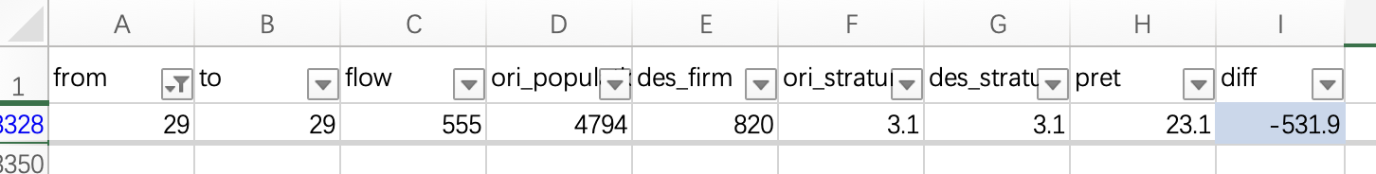
The Model

